Slide 1
Cloud Computing and Modern Applications
December 2022
Notes:
Hello. Thank you for joing us today.
For those who don't know me. My name is Fares Ghanimah. I lead the Central Technology group here at William Blair.

Slide 2
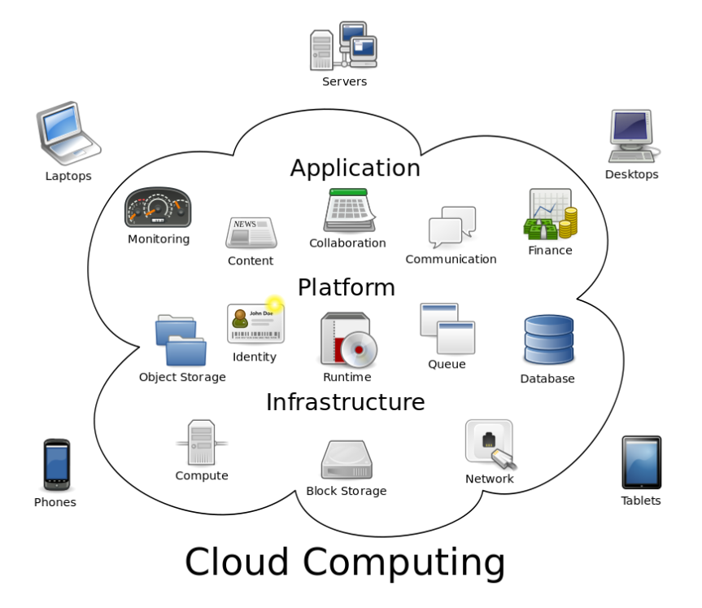
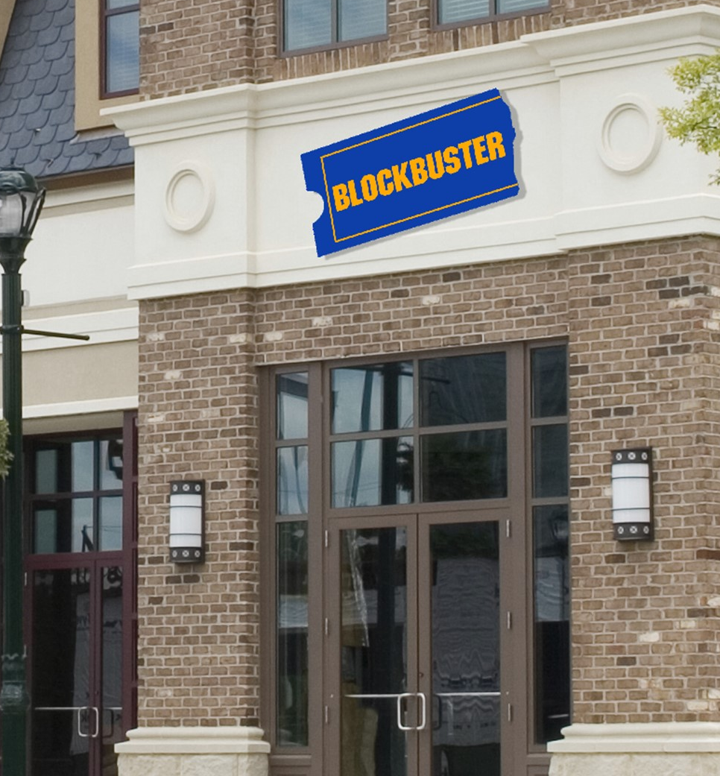



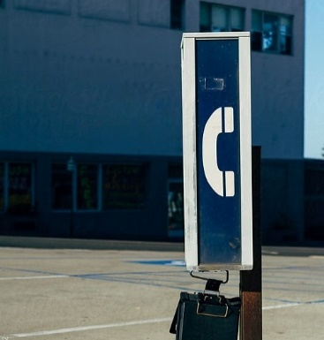
Every company today is a data driven company
Cloud Computing and Modern Applications

Slide 3
Goals / Audience
Agenda / Objective
What is the cloud?
How does Blair use the cloud?
What is coming next – Project Trident?
Case Studies
Customer Designs
Call to action
ESI (Free Azure Training and Certifications https://esi.microsoft.com)
Get certified at minimum AZ-900

Slide 4
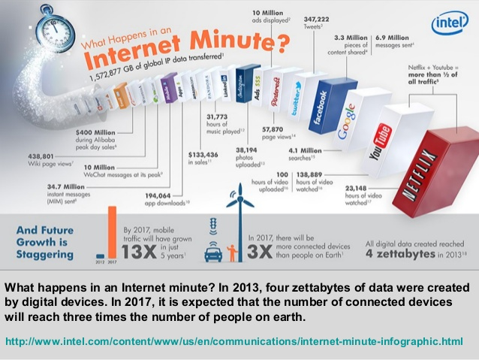
The Cloud is driving our tech world today

Slide 5
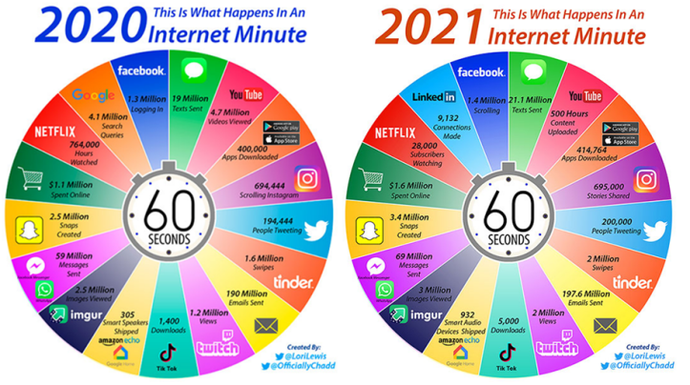
The Cloud is driving our tech world today

Slide 6
What is the Cloud
Notes:
Let's get started.

Slide 7
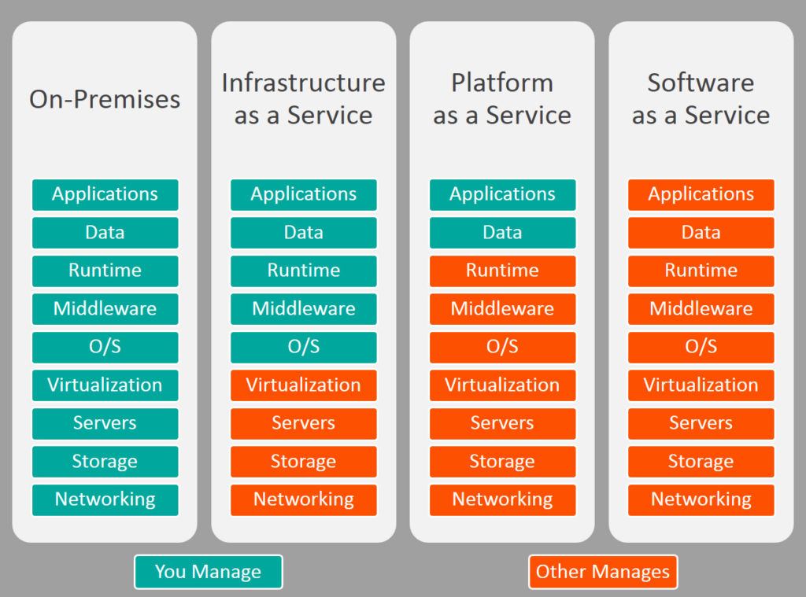
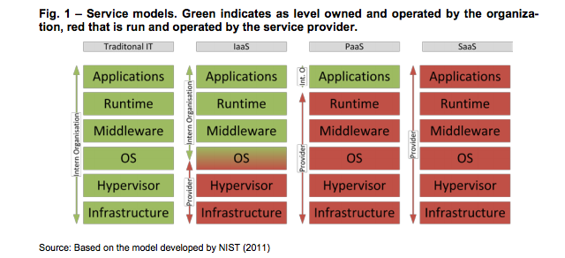
What is the cloud?
Green indicates the levels owned and operated by William Blair
Red levels are run and operated by our service providers

Slide 8
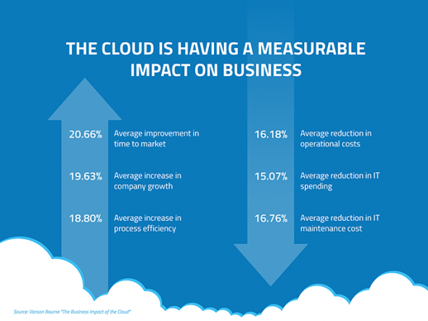
Why cloud Computing?
Competitive Advantage
Efficiency / cost reduction
Data security
Scalability
Mobility
Disaster recovery
Control over your data
https://www.globaldots.com/cloud-computing-benefits/

Slide 9
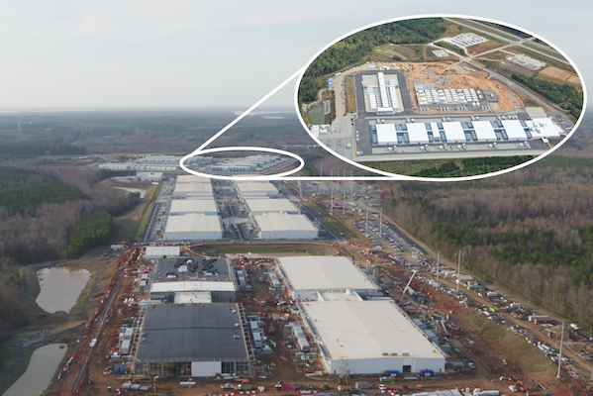
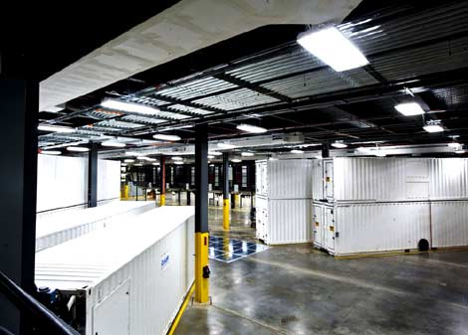
What is the cloud?

Slide 10
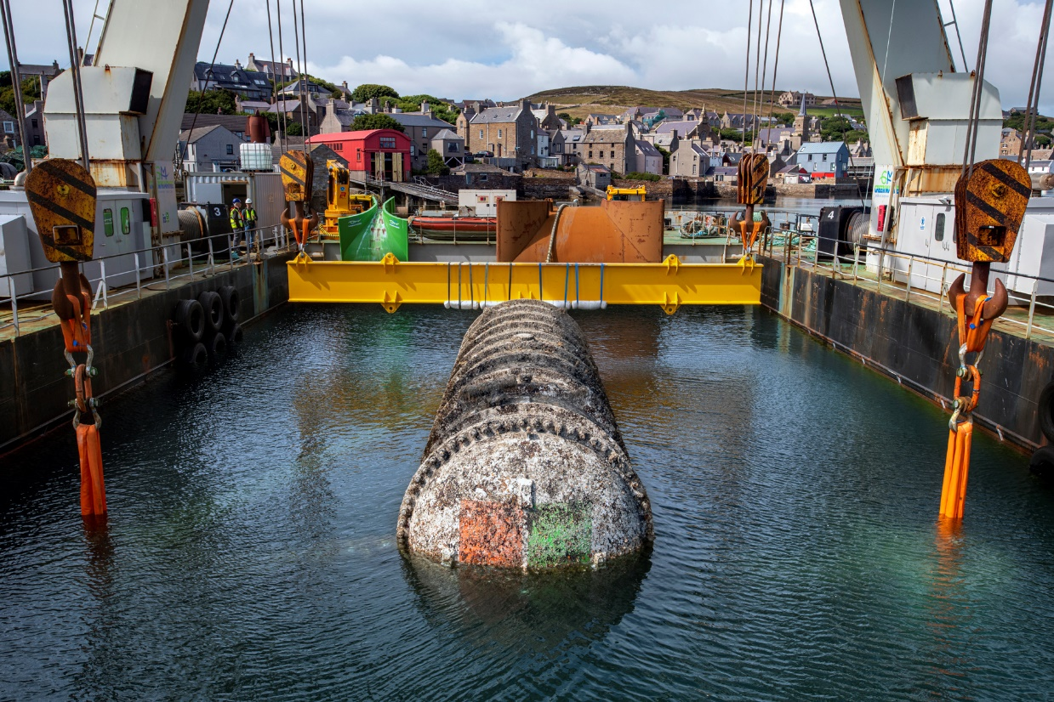
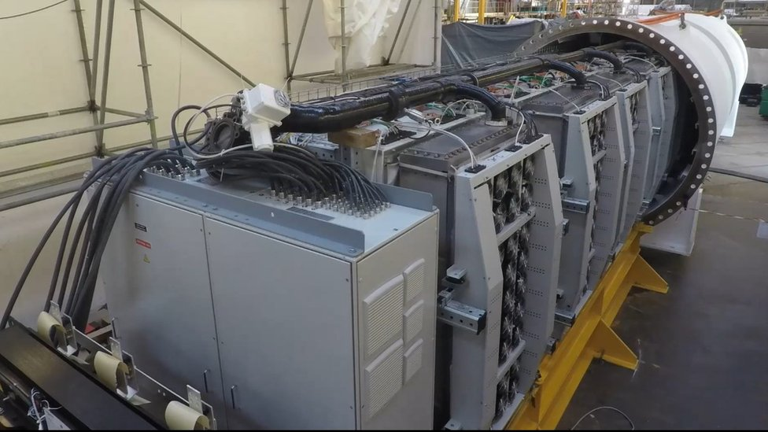
What is the cloud?

Slide 11
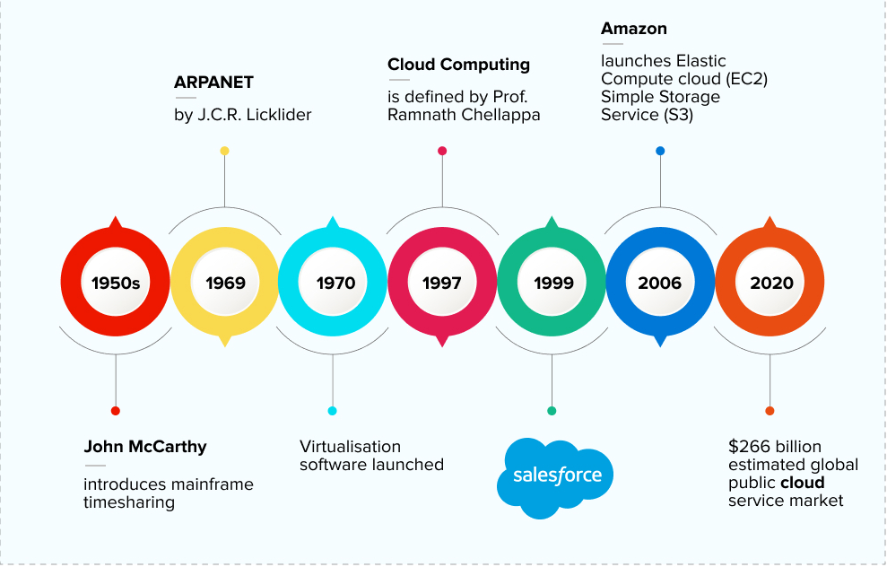
History of Cloud Computing

Slide 12
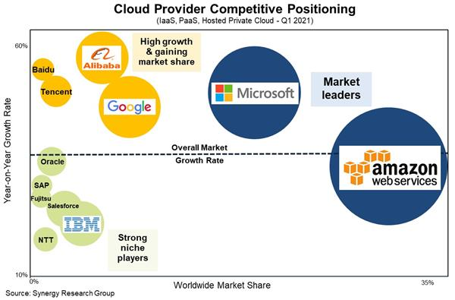
Who’s who in Cloud today

Slide 13
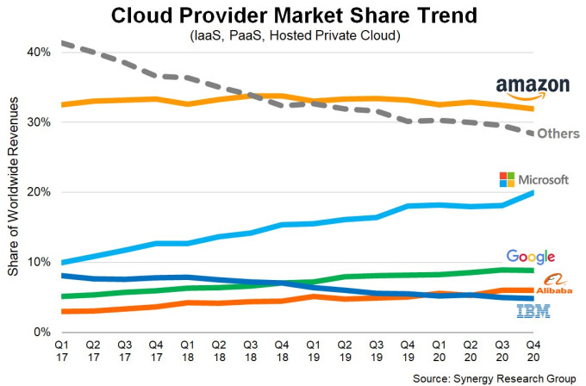
Cloud Provider Market Share Over Time

Slide 14
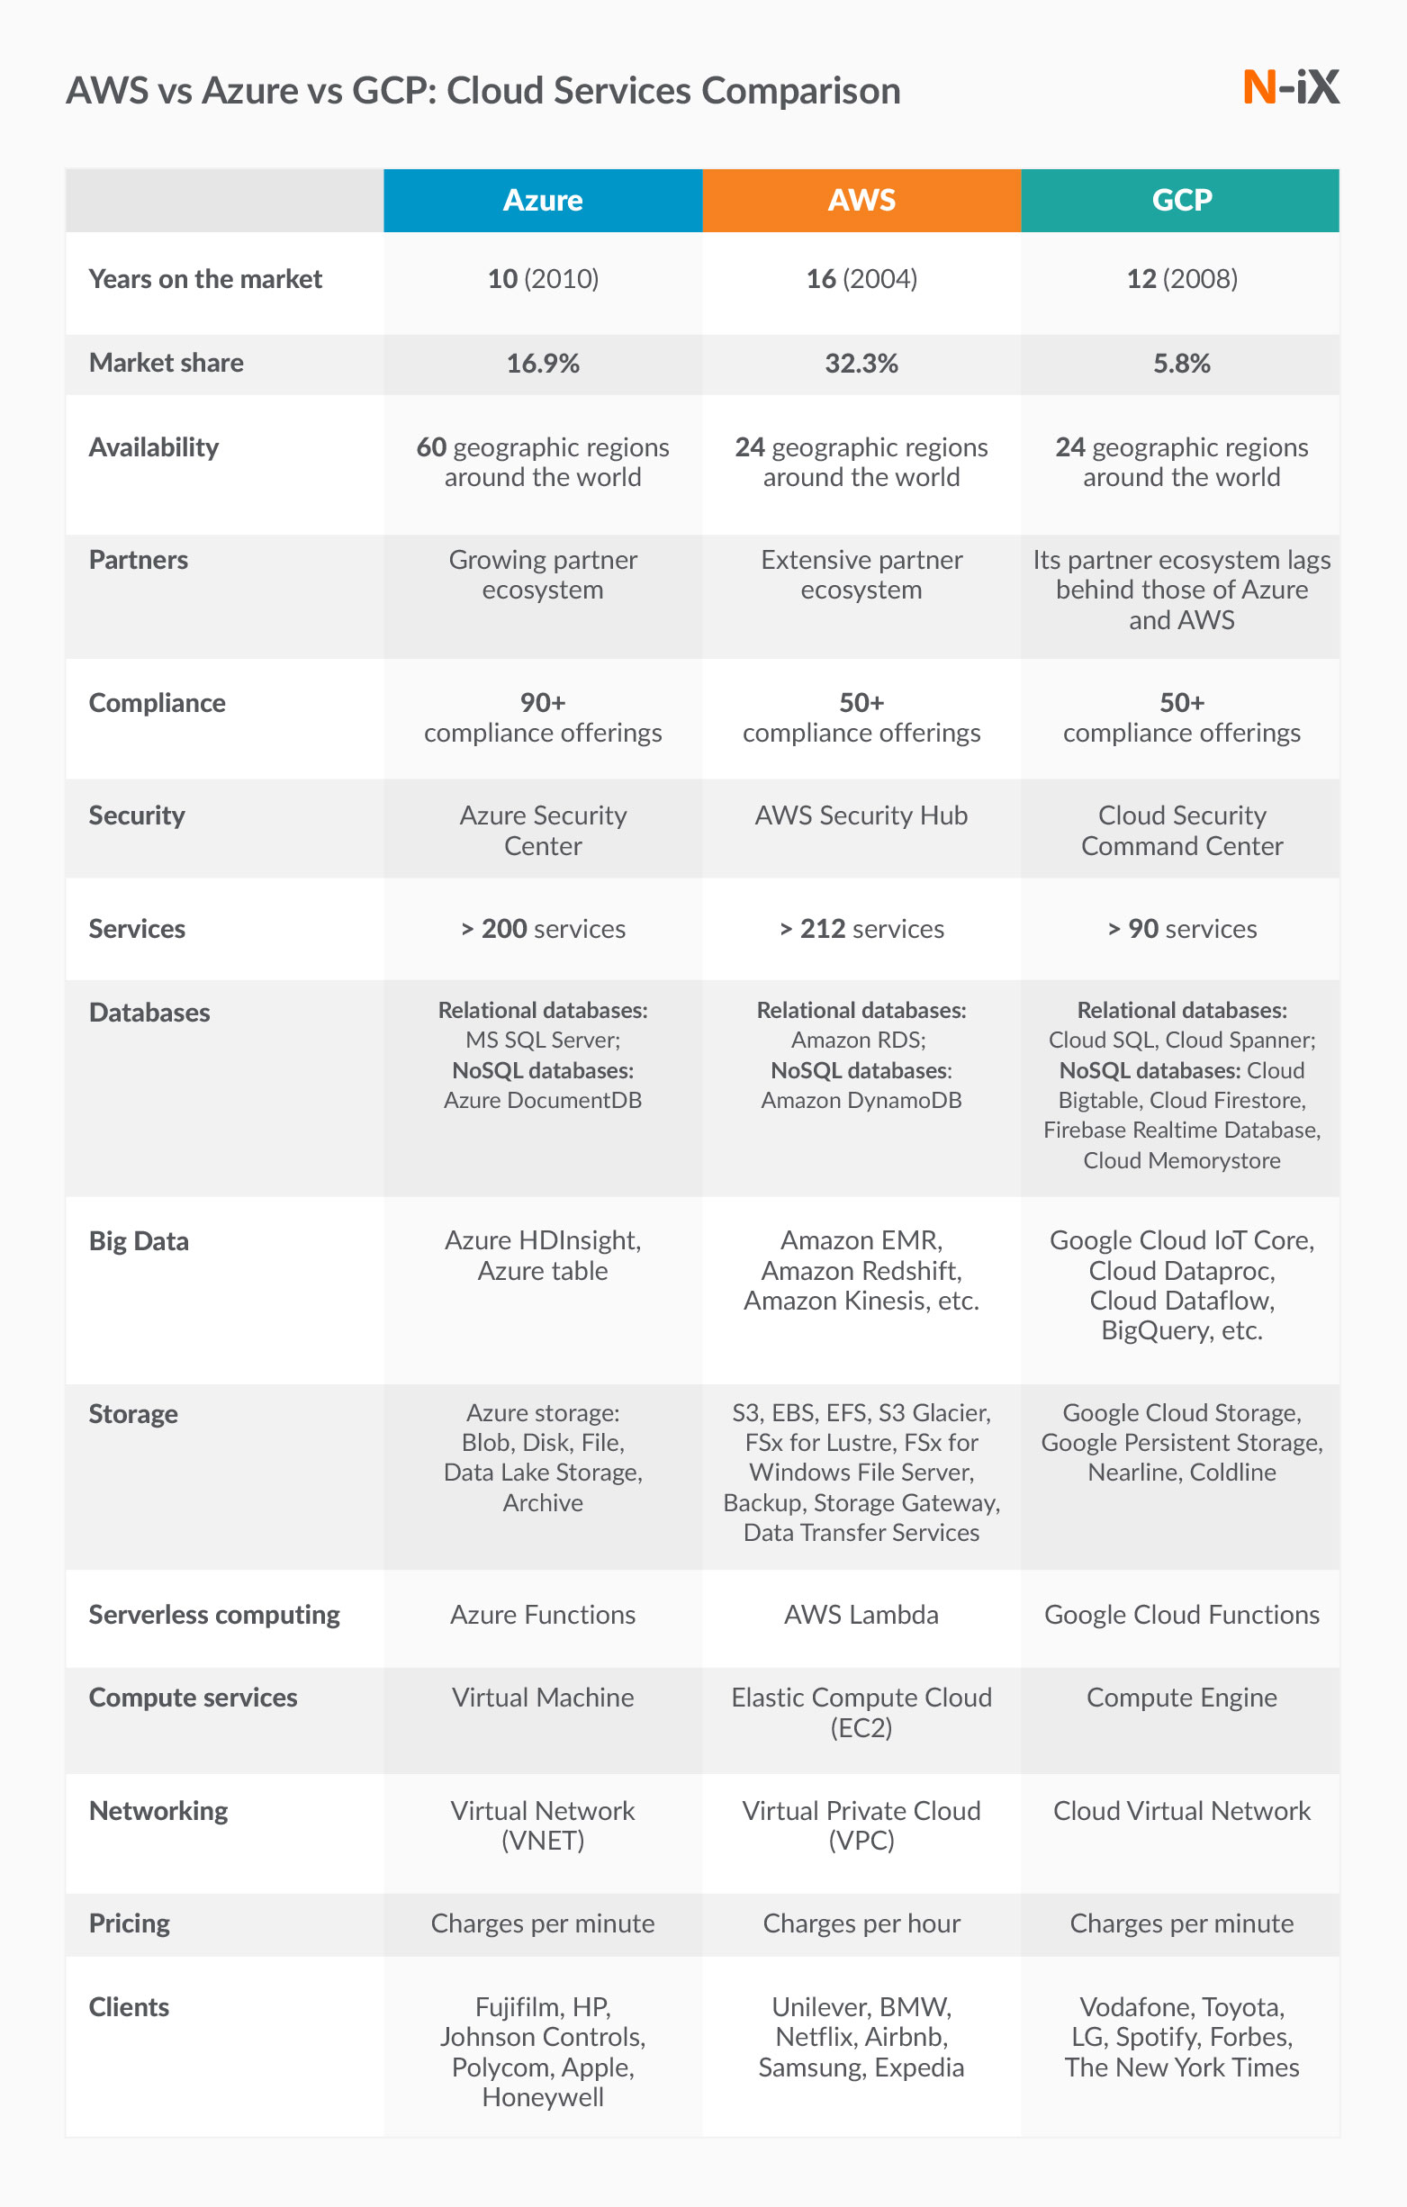
Cloud Provider Market Share Over Time

Slide 15
Cloud Provider Market Share Over Time

Slide 16
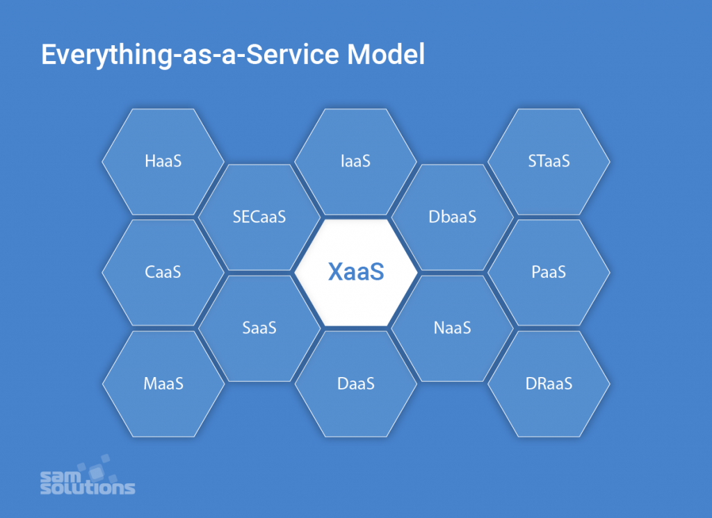
In Cloud Computing – Everything is an “aaS” (as a Service)

Slide 17

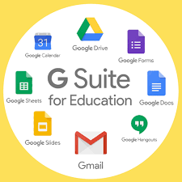


SaaS - Software as a Service
License and away we go!!
Social Media Sites
G Suite
Canvas and PowerSchool
Financial Sites

Slide 18


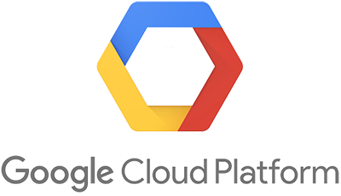
Let’s look closer at: IaaS – Infrastructure as a Service & PaaS – Platform as a Service

Slide 19

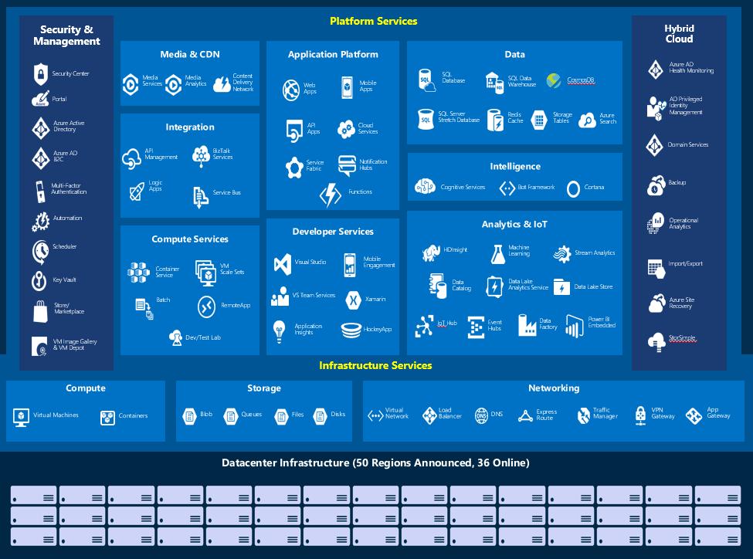
Microsoft Azure IaaS & PaaS

Slide 20

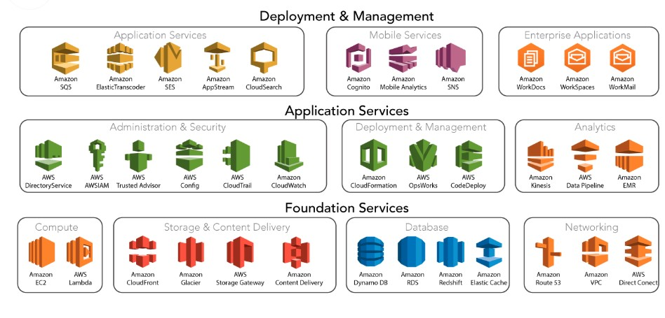
AWS IaaS & PaaS

Slide 21

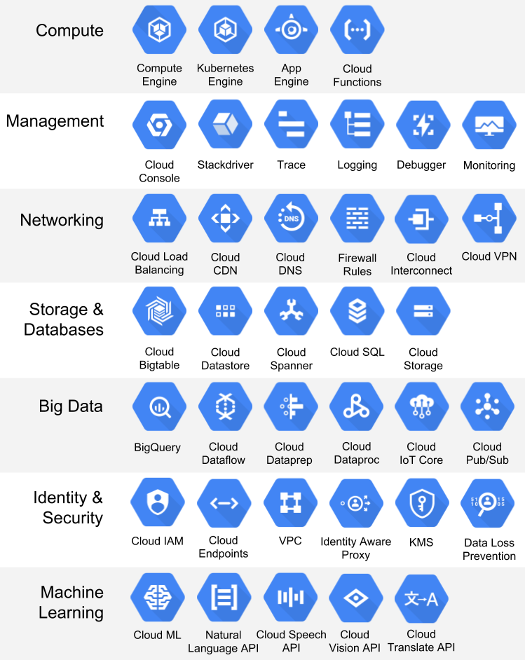
GCP IaaS & PaaS

Slide 22
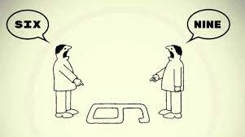
If you know one Cloud… You know them all

Slide 23

Cloud Computing and Modern Applications

